Slide 1

Optional4J: Automated Declarative Optionality and Nullity for Java
Saleh Amareen
Department of Computer Science
Wayne State University, Detroit, MI, USA

Slide 2
Overview
Motivation.
Origin of null.
Impact of null.
Existing tools.
Optional.
Optional4J.
Three premises
Null Object
Null Operator
Performance evaluation.

Slide 3
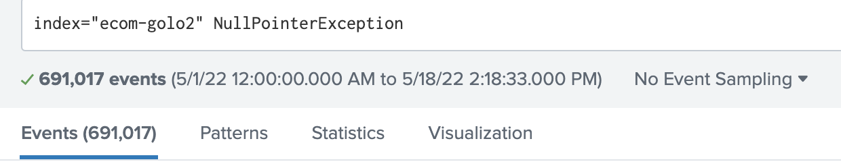
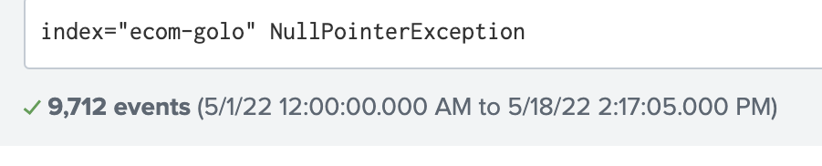
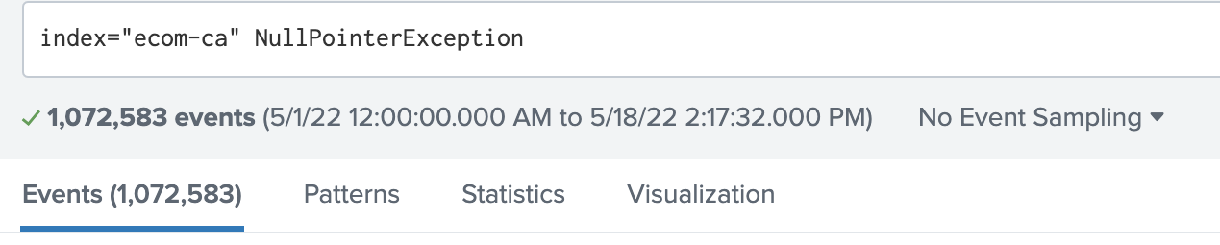
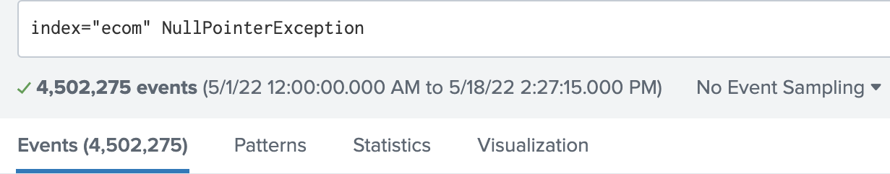
Motivation: NPEs @Domino’s?

Slide 4




Motivation Cont. NPEs elsewhere
5% of all Android App errors
41.7% of memory bugs
37.2% of memory bugs
342 and 308 security vulnerabilities, 2020 & 2021
Notes:
Null is flexible, easy to write, supports patterns such as LinkedList
Uber’s 5% was even after leveraging NullAway.

Slide 5

Origin of null
“I call it my billion-dollar mistake. It was the invention of null in 1965”.
Tony Hoare.
Notes:
Easy to implement
Focused on language proof rather than projections of null impact

Slide 6






Negative Impact of null
Customer facing
Impact radius
Long fix cycle
return null → higher cost factor
Mobile Apps
Software Cost
NPEs lack root cause
JEP-358
Cyclomatic complex
Code refactoring
Tracing & Debugging
Code
Comprehension

Slide 7

Impact of null - code comprehension
Tedious
Obfuscating
Obscuring
Forgettable
Distracting
Repetitive
Code smell
Cluttering
Error-prone
Indirect
Notes:
Reading throughout previous papers in the literature
Programmers dealing with null on a daily basis is a process that was described as…
Image reference: https://insights.dice.com/2019/06/03/burnout-now-official-medical-condition/

Slide 8
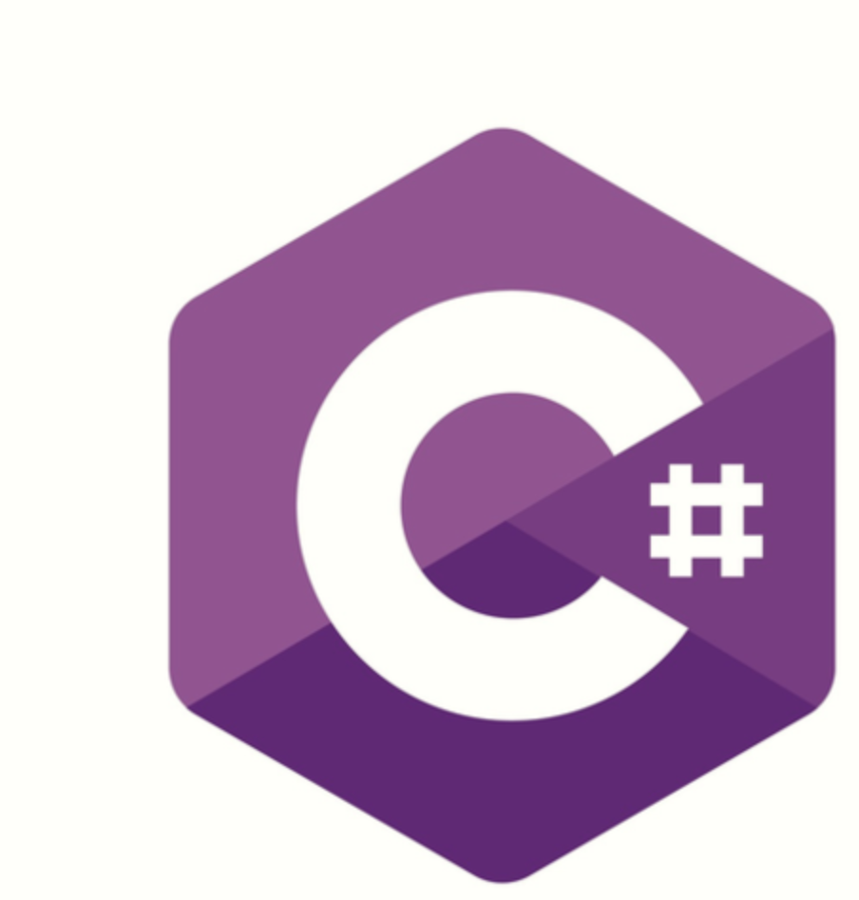



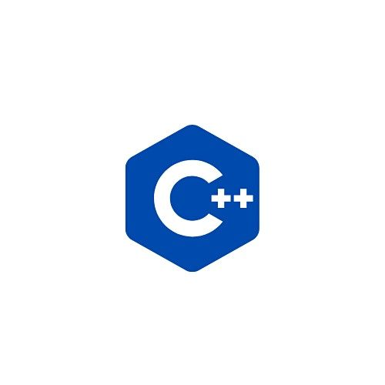

null-Safety in Programming Languages.
Swift
Spec#
Rust

Slide 9


null-Safety in Programming Languages.
Rust
Swift
Spec#

Slide 10
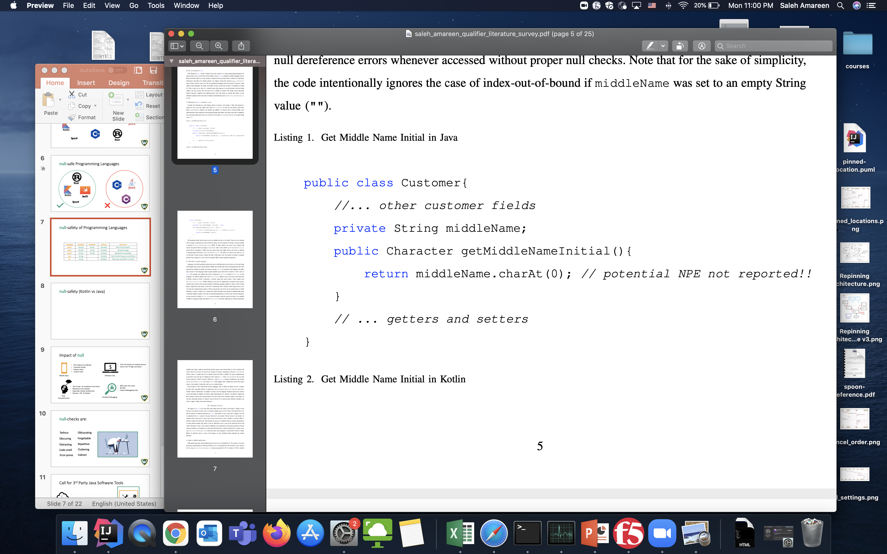
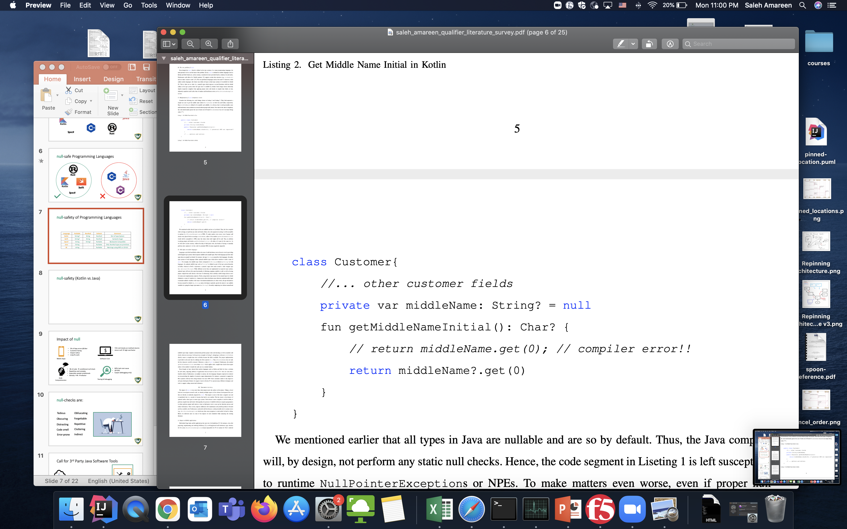
Example: null-safety (Java vs Kotlin).
Java
Kotlin

Slide 11




All types are NULLABLE!!
help
null?
Notes:
Given the shortcomings of the Java type system and lack of support from the compiler.

Slide 12



Java Third Party Tools
1. Static Analysis Tools (SATs).
2. Pluggable Type Checkers.
Nullness Checker - Checker Framework.
Eradicate - Facebook Infer.
NullAway - Uber.
3. Gradual Type Checkers.
Annotation Burden.
Unchecked assumptions.
Unsound assumptions.
False Positives.
Build time – only at CI/DC.

Slide 13
Java Third Party Tools Cont.
1. Optional Type/Class:
Google Guava.
Java.
2. Design Patterns:
Null Object Pattern.
3. Individual efforts:
Syntactic Sugar.

Slide 14

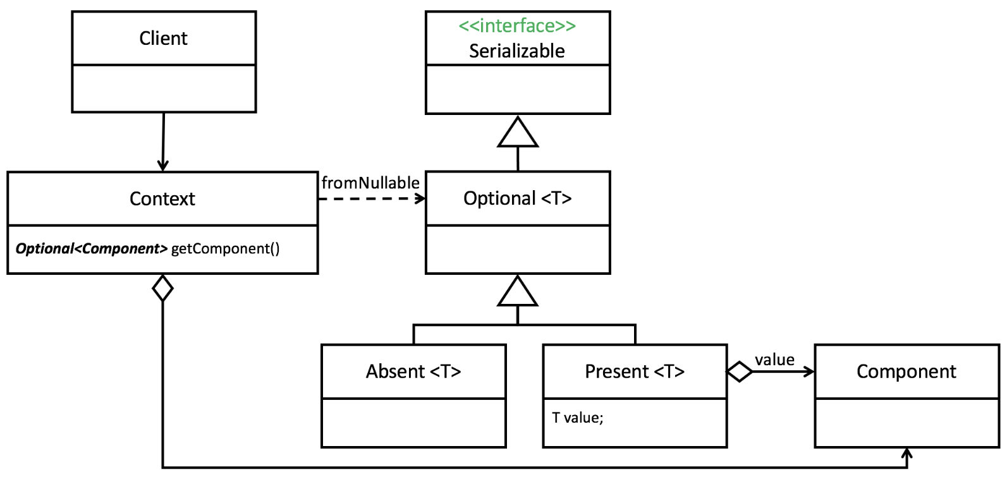
Optional - Google Guava

Slide 15
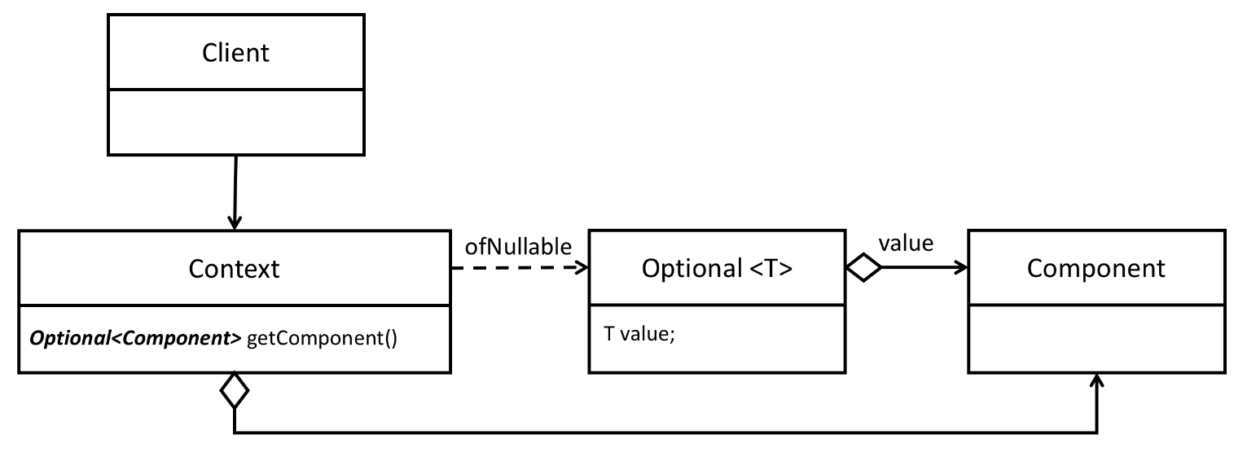
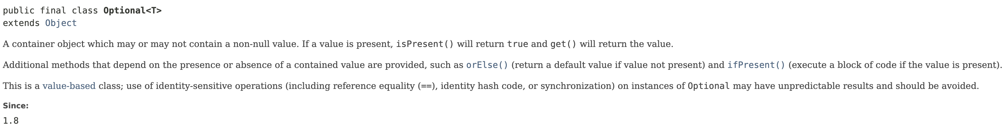
Optional - Java 8
Limitations?
- Performance
- Serializability
- Identity
- Equality
- Usability
- Extensibility

Slide 16
Optional4J
Lightweight code generation and transformation tool to address Optionality and Nullity in Java.

Slide 17
Optional4J’s Premise #1
“70% of null-check conditional statements are
due to null-returning methods.”
717 Open-source Java Systems

Slide 18
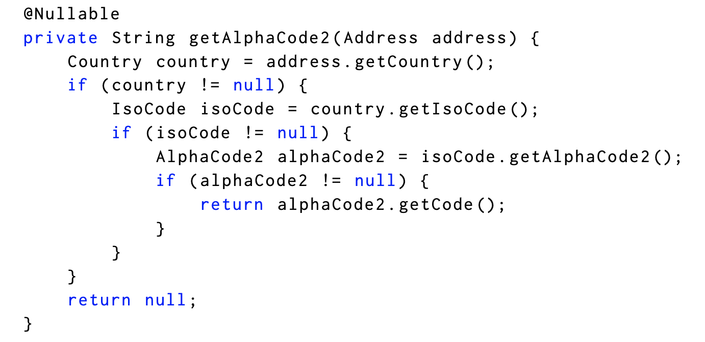
Use Optional?

Slide 19
Optional4J’s Premise #2
There is a significant burden involved with (re)writing code with Optional wrappers.

Slide 20
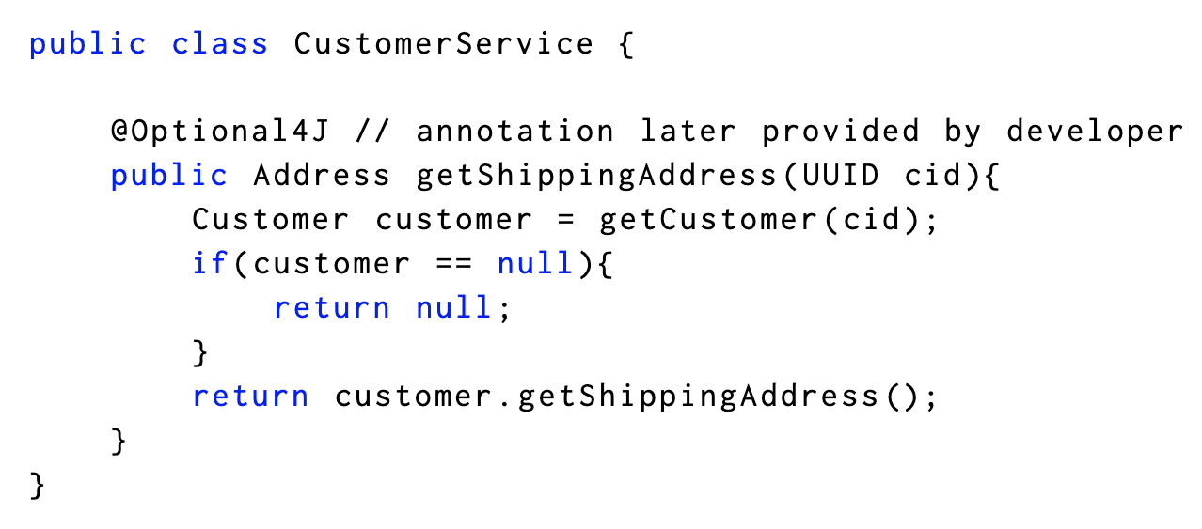
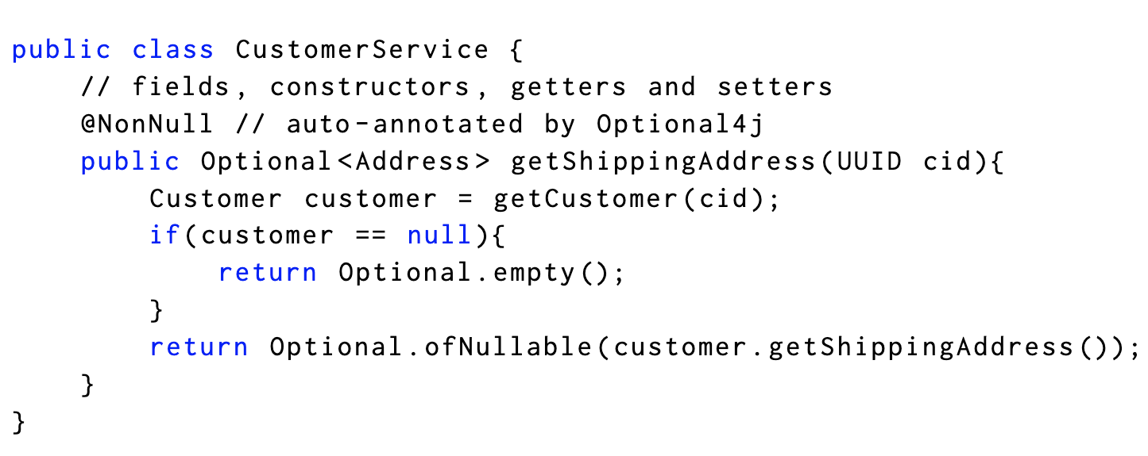
Can we automate Java’s Optionalization?
Java Spoon
JSR-305

Slide 21
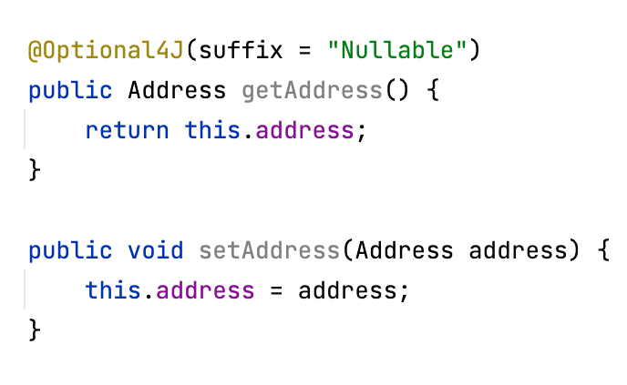
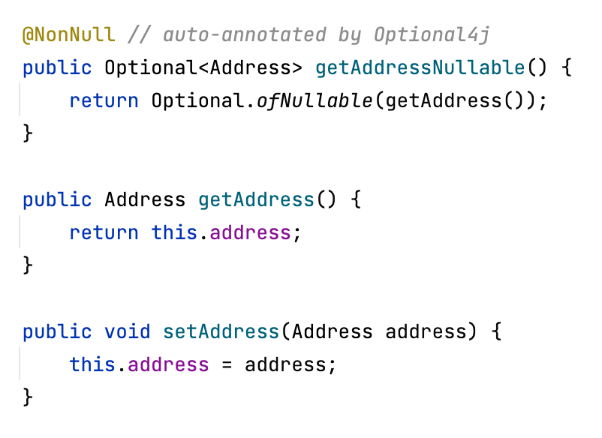
Can we keep it as an additive change?
Java Spoon
Performance?
Overuse?
Serialization?

Slide 22
Optional4J’s Premise #3
The notion that,
a new Java Optional instance is created iff the wrapped instance is NOT null,
is counterintuitive.
Throughput??
Garbage collection??

Slide 23
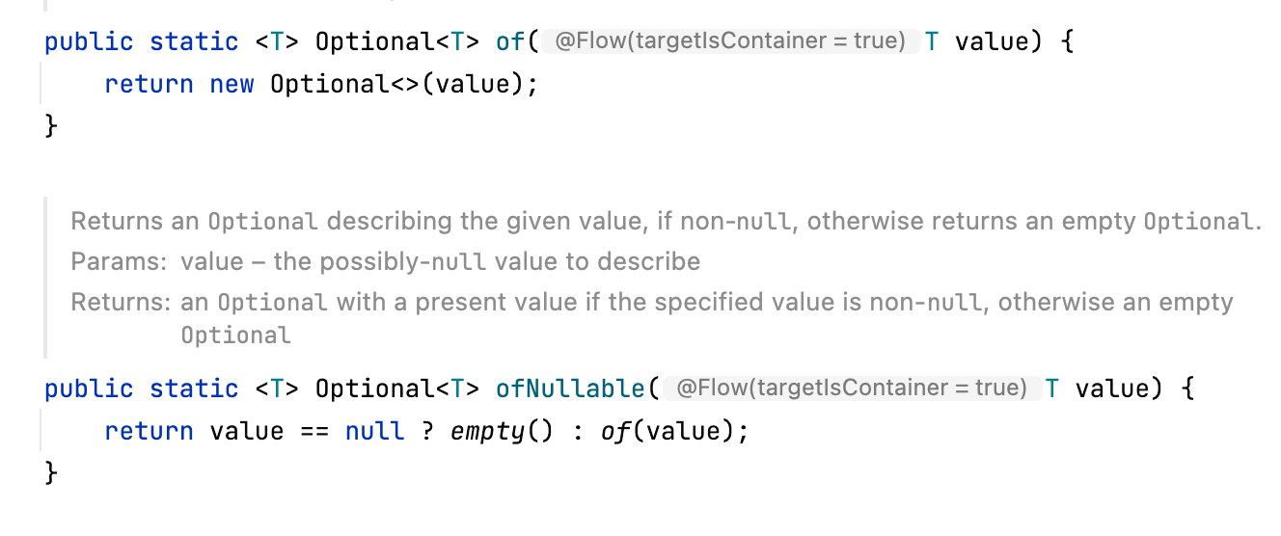
Optional4J’s Premise #3 Cont.
Bad design!

Slide 24
Optional4J’s Premise #3 Cont.
Optional (EMPTY)
Optional.ofNullable(customer)
Optional
new
customer

Slide 25
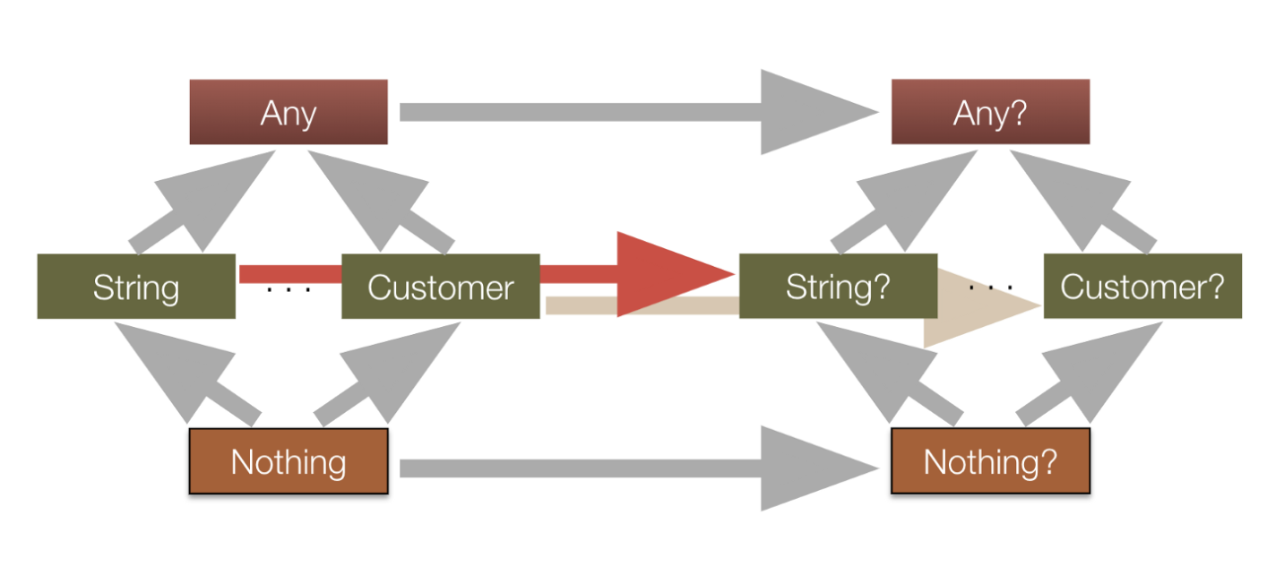
Simplified Kotlin Type System
Nominal Subtyping
Bounded Parametric Polymorphism
Source: https://blog.kotlin-academy.com/the-beauty-of-kotlin-typing-system-7a2804fe6cf0

Slide 26
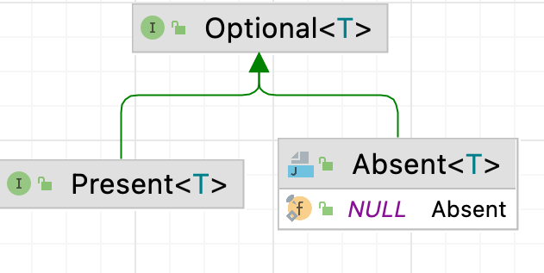
Change “has a” relationship to “is a” relationship
NULL
Solves:
- Performance
- Serializability
- Identity
Optional.ofNullable(customer)
- Equality
X
customer
- Usability
new
- Extensibility

Slide 27
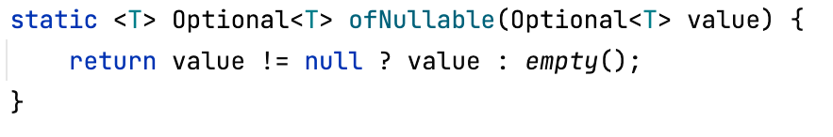
Optional4J - ofNullable

Slide 28
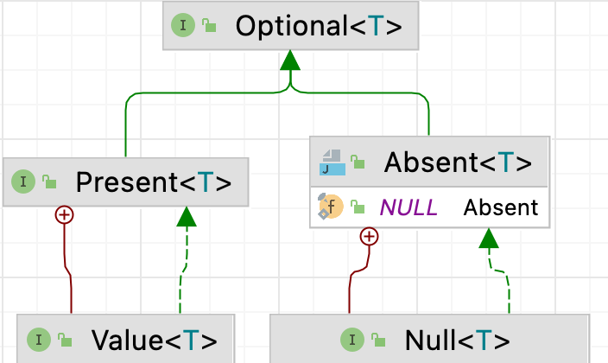
Optional4j Object Model

Slide 29
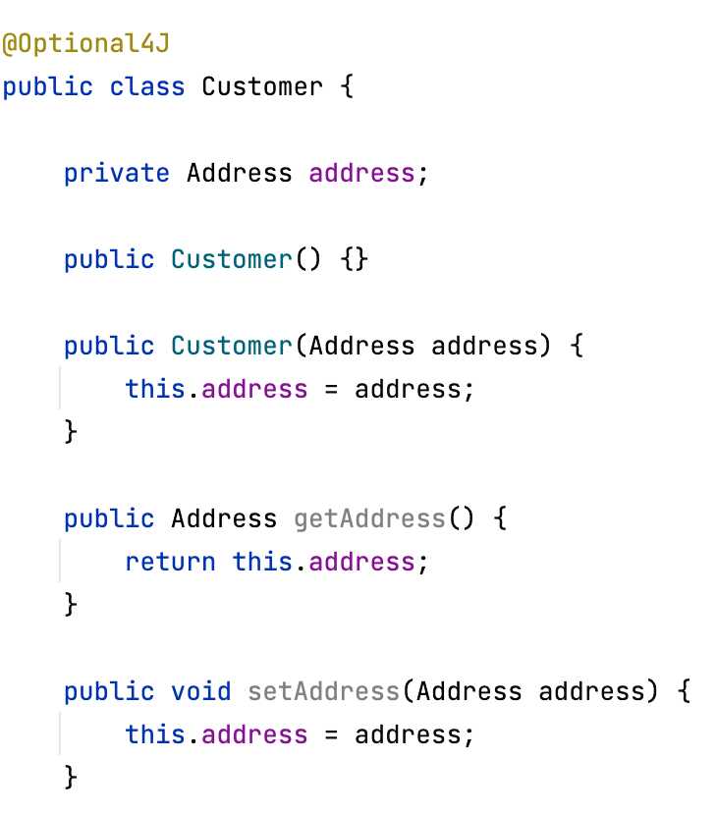
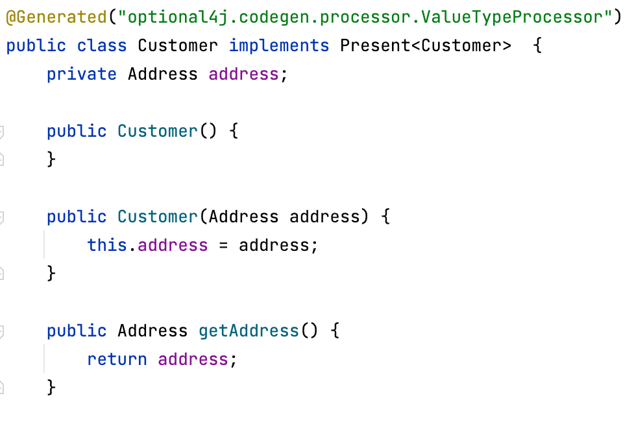
Can we automate?
Java Spoon

Slide 30
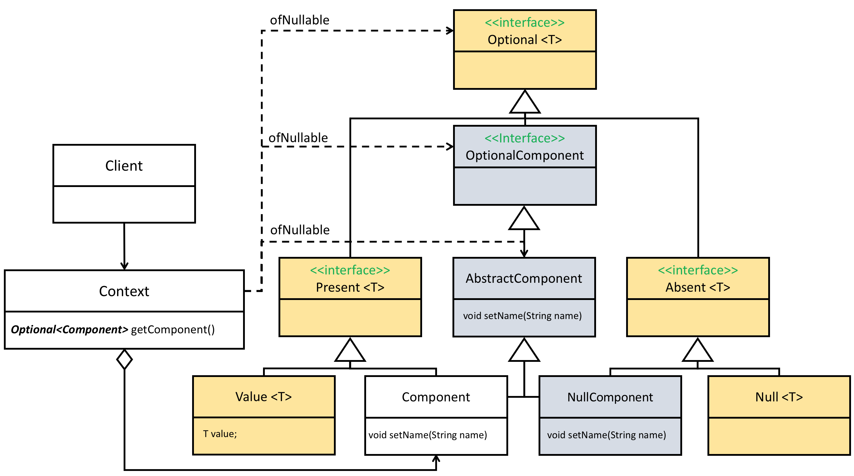
Optional4j Extended Object Model
Component?

Slide 31
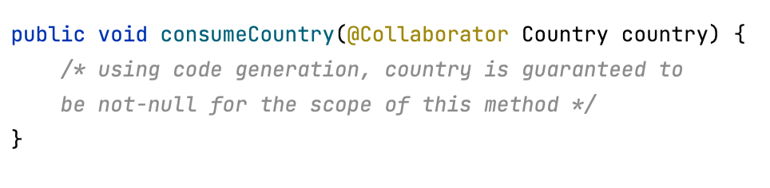
NullObject - Extensibility
DoNothing Collaborator

Slide 32
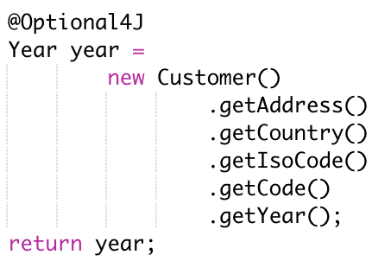
null-safe Method Invocation
Reminds you of the safe-navigation operator ?.

Slide 33
Recap: Optional4J Applicability
Classes:
Optimized Optional Types.
Method returns:
Method Optionalization.
Compiler-level null safety.
Method Parameters:
Null Object Pattern.
Local variables:
Safe-call null operator.

Slide 34
Optional4J Evaluation

Slide 35
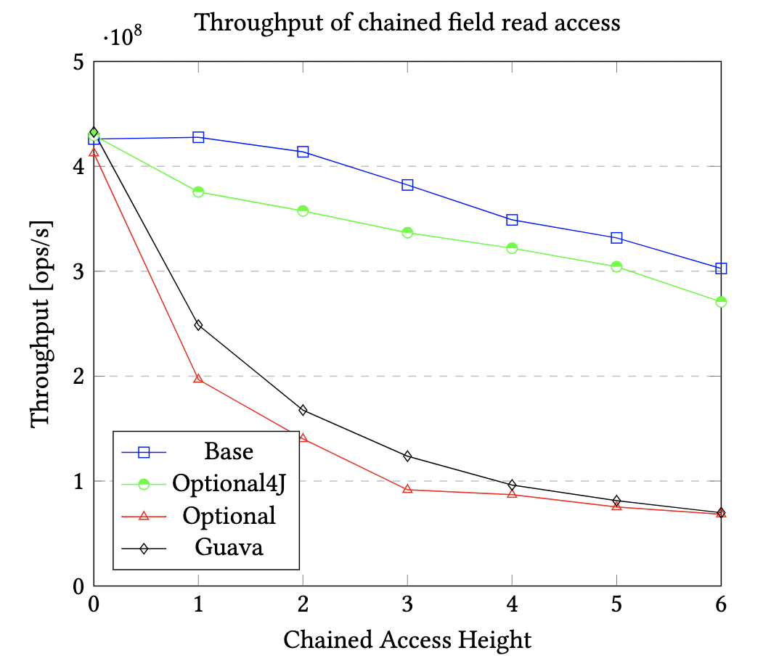
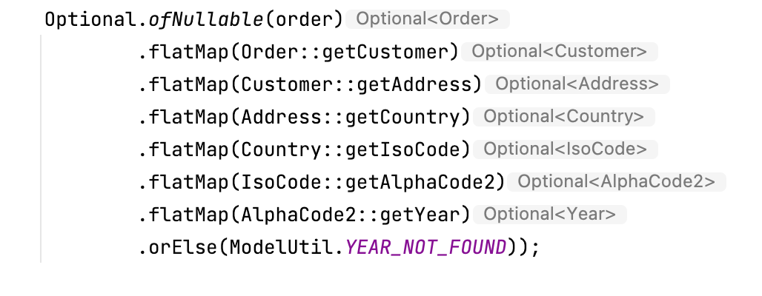
Chained Access (JMH).
- Chained Access Height = 2
- Chained Access Height = 4

Slide 36
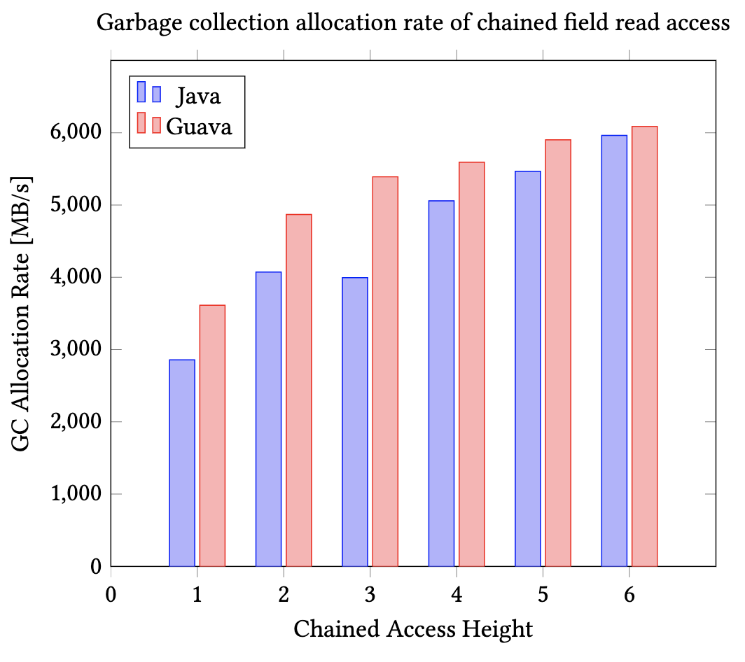
Garbage Collection (JMH).

Slide 37
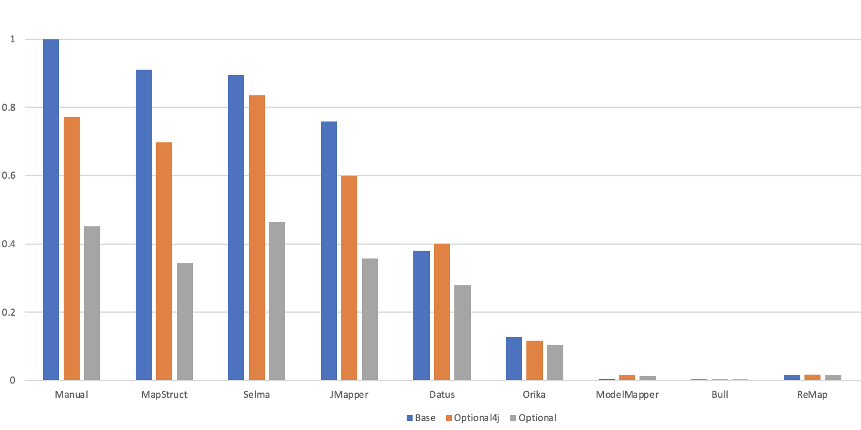
The Java Mapper Benchmark (JMH).

Slide 38

Questions?!

Slide 39
null-safety of Programming Languages
Language | Nullable | NonNull | Default | Comment
Kotlin | String? | String | NonNull | Part of type System
Swift | String? | String | NonNull | Syntactic Sugar Optional<String>
C# | string | - | Nullable | Warnings using NRTs in C# 8.0
Spec# | String | String! | Nullable | Backwards Compatible
Java | String | - | Nullable | Only NonNull type are primitives

